Slide 1



Home
About Us
News
Gallery
Performers
Support Us
Sign Up
Barrier Reef Orchestra – A North Queensland Icon
Fast becoming one of North Queensland’s cultural jewels the Barrier Reef Orchestra this year launches its 15th year of performing orchestral music throughout North Queensland. A community orchestra consisting of the finest musicians drawn from as far afield as Cairns and Mackay, it focuses on unique orchestral juxtapositions. An outstanding performance of Beethoven’s 9th Symphony presented to a sell-out audience was recently followed by Peter Sculthorpe’s Mangroves, a collaboration with audio-visual artists, ABC radio and Umbrella Studios. The programs are testament to the orchestra’s willingness to embrace mainstream classical repertoire as well as opportunities for collaboration. In 2015 the orchestra has been invited to perform in three festivals, and features in the Townsville Civic Theatre season. This is a first for the orchestra - underscoring its value to the community and highlighting its continued prominence in the cultural soundscape of North Queensland.

Slide 2
Home
About Us
News
Gallery
Performers
Support Us
Sign Up
About Us
The Barrier Reef Orchestra is a product of North Queensland Ensembles Inc. North Queensland Ensembles Inc. is an Incorporated Association registered in the State of Queensland. It is also a tax deductible fund listed on the Register of Cultural Organisations under Subdivision 30-B of the Income tax Assessment Act 1997. It is based in Townsville, North Queensland, Australia.
North Queensland Ensembles Inc Management Committee 2015
President: | Andrew Ryder
Vice-President: | Judy Hunter
Secretary: | Lorraine Gray-McConnell
Treasurer: | Annette Ellis
Committee: | Caroline Arlett

Slide 3
Home
About Us
News
Gallery
Performers
Support Us
Sign Up
History
Contact Us
Documents
[NOTE, DROPBOX SLIDE, NO CONTENT]

Slide 4
Home
About Us
News
Gallery
Performers
Support Us
Sign Up
History
Over a two-year period in the late nineties, Townsville musicians, arts workers and a group of people who had a love for music realised the potential for developing a community-based Orchestra — one that would flourish and become an integral part of the City’s cultural life.
In 2000 to ‘test’ the viability of establishing an Orchestra a weekend workshop was arranged and musicians were invited to participate under the baton of Richard McIntyre, Senior Lecturer at the Canberra School of Music and the result — the Barrier Reef Orchestra was born.
During the past few years, the Orchestra has performed with the comedy-duo Scared Weird Little Guys in Score, Townsville City Council’s Last Night of the Proms and A Christmas Carol. In 2003 the Council’s centenary year the Orchestra took part in Encore, as well as playing a major role in the Townsville Civic Theatre’s 25th Anniversary productions of Noye’s Fludde and Carmina Burana.

Slide 5
Home
About Us
News
Gallery
Performers
Support Us
Sign Up
Contact Us
Have anything you need to contact us about? Any problems? Then fill out the following form below, and we will send you back a response as soon as possible!
First Name *
Last Name *
Email Address *
Telephone Number
Notes *

Slide 6
Home
About Us
News
Gallery
Performers
Support Us
Sign Up
Documentation
Annual General Meeting 2015 Notices (344KB)
Membership/Player Application Form (955KB)
Barrier Reef Orchestra Concert Educational Resource (1,307KB)
Benefactor Form (3,777KB)
North Queensland Ensembles Inc. Rules 2010 (66KB)

Slide 7
Home
About Us
News
Gallery
Performers
Support Us
Sign Up
News
World Music Concert
As you travel the globe one of the standout features of so many different countries is undoubtedly their music. This concert saves on the shoe leather and brings an eclectic mix of music from all over the world to Townsville. A unique performance conceptualised and developed here in Townsville by the Barrier Reef Orchestra highlighting the stunning diversity of cultural music from around the globe. Featuring the Orchestra and several international artists performing music from Asia, the Americas, the British Isles, Europe and of course Australia. So pack away the passport take the trip of a life time and never leave home. Join Townsville’s very own Barrier Reef Orchestra in their 15th year for a World Music Concert.
Special guests
Adam Lopez – Developed his multi-octave, voice while studying opera in Australia more....

Slide 8
Home
About Us
News
Gallery
Performers
Support Us
Sign Up
Events
[NOTE, DROPBOX SLIDE, NO CONTENT]

Slide 9
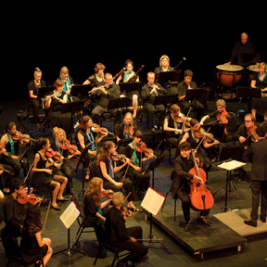
Home
About Us
News
Gallery
Performers
Support Us
Sign Up
Events
SUNDAY August 2nd 25th Anniversary Celebration Concert – The 1812! Queen's Gardens, 3:00 PM Presented by Townsville City Council and AFCM Free Public Event Hosted by Damien Beaumont ABC Classic FM
Copland Fanfare for the Common Man Conducted by Andrew Ryder Barrier Reef Orchestra, 1RAR Band, Ben Jacks
Walton Crown Imperial Conducted by Andrew Ryder Barrier Reef Orchestra

Slide 10
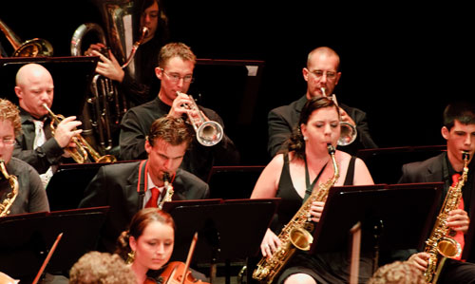
Home
About Us
News
Gallery
Performers
Support Us
Sign Up
The previous gallery section shows if the “super back” button is pressed
Gallery
The next gallery section shows if the “super forward” button is pressed
Hot Summer’s Night 2008
Pictures move this way if the “forward” button is pressed
Pictures moves this way if the “back” button is pressed
<<
<
II
>
>>

Slide 11
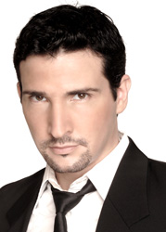
Home
About Us
News
Gallery
Performers
Support Us
Sign Up
Performers
Adam Lopez - Vocal
Adam Lopez’s exceptional vocal artistry has paved opportunities to perform backing vocals for some of the biggest names in the music industry such as Mariah Carey, Keith Urban and The Coors. His most recent noted collaboration was headlining with Australian Jazz legend James Morrison in a string of Symphonic Concerts in Perth, Hobart and Brisbane.
His discography includes an eclectic collection of genres spanning from Pop-Opera, Pop, Rhythm & Blues, Jazz, Power Ballads and Fiery Latin!

Slide 12
Home
About Us
News
Gallery
Performers
Support Us
Sign Up
Support Us
North Queensland Ensemble Inc.
Sponsor or Donate to the Orchestra
The North Queensland Ensembles Inc is a tax deductible fund listed on the Register of Cultural Organisations under Subdivision 30-B of the Income tax Assessment Act 1997. Donations of $2.00 or more are tax deductible.
Help us continue to provide quality entertainment for the Townsville community by supporting the orchestra. Click on the buttons below to view our current supporters.
Benefactors Roll
Sponsors

Slide 13
Home
About Us
News
Gallery
Performers
Support Us
Sign Up
Barrier Reef Orchestra Benefactors' Roll
Carol Dall'Osto
Councillor Ray Gartrell
Bruce Gibson and Dorothy Gibson-Wilde O.A.M.
Dr Kerry Gillespie
Judy Hunter O.A.M.
Ewen Jones MP
David and Janine Kippin
Simon and Lorraine McConnell
Senator Ian McDonald
Dr Maria Moon
Terry O'Toole
Bronia and Neil Renison
Desley Wheeler
Graham Wheeler
Nita Vasilescu

Slide 14






Home
About Us
News
Gallery
Performers
Support Us
Sign Up
Sponsors

Slide 15
Home
About Us
News
Gallery
Performers
Support Us
Sign Up
Become a Member
Become a Player
[NOTE, DROPBOX SLIDE, NO CONTENT]

Slide 16
Home
About Us
News
Gallery
Performers
Support Us
Sign Up
Become a Member
Would you like to become a member of the Barrier Reef Orchestra? Then sign up here!
Alternatively, become a benefactor here!
First Name *
Last Name *
Email Address *
Telephone Number

Slide 17
Home
About Us
News
Gallery
Performers
Support Us
Sign Up
Become a Player
Would you like to become a musician for the Barrier Reef Orchestra? Then sign up here!
First Name *
Last Name *
Email Address *
Telephone Number
Position (list multiple if possible) *

